Slide 1
Intro to Machine Learning – week 3

Slide 2
Today’s class
Simple linear regression (one predictor)

Slide 3
Today’s class
Simple linear regression (one predictor)
Multiple linear regression (many predictors)
How to select predictors
Quantitative versus qualitative predictors
Problems

Slide 4
Today’s class
Simple linear regression (one predictor)
Multiple linear regression (many predictors)
How to select predictors
Quantitative versus qualitative predictors
Problems
Other regression techniques
Ridge, Lasso, Elastic Net, Principal Component Regression, Total Least Squares

Slide 5

Simple linear regression (ordinary least squares)
One input, one target
$Y= β_{0}+ β_{1}∗X$

Slide 6

Simple linear regression (ordinary least squares)
One input, one target
$Y= β_{0}+ β_{1}∗X$
Inflexible: assumes a linear relationship
Parametric: fixed size of parameters to estimate

Slide 7
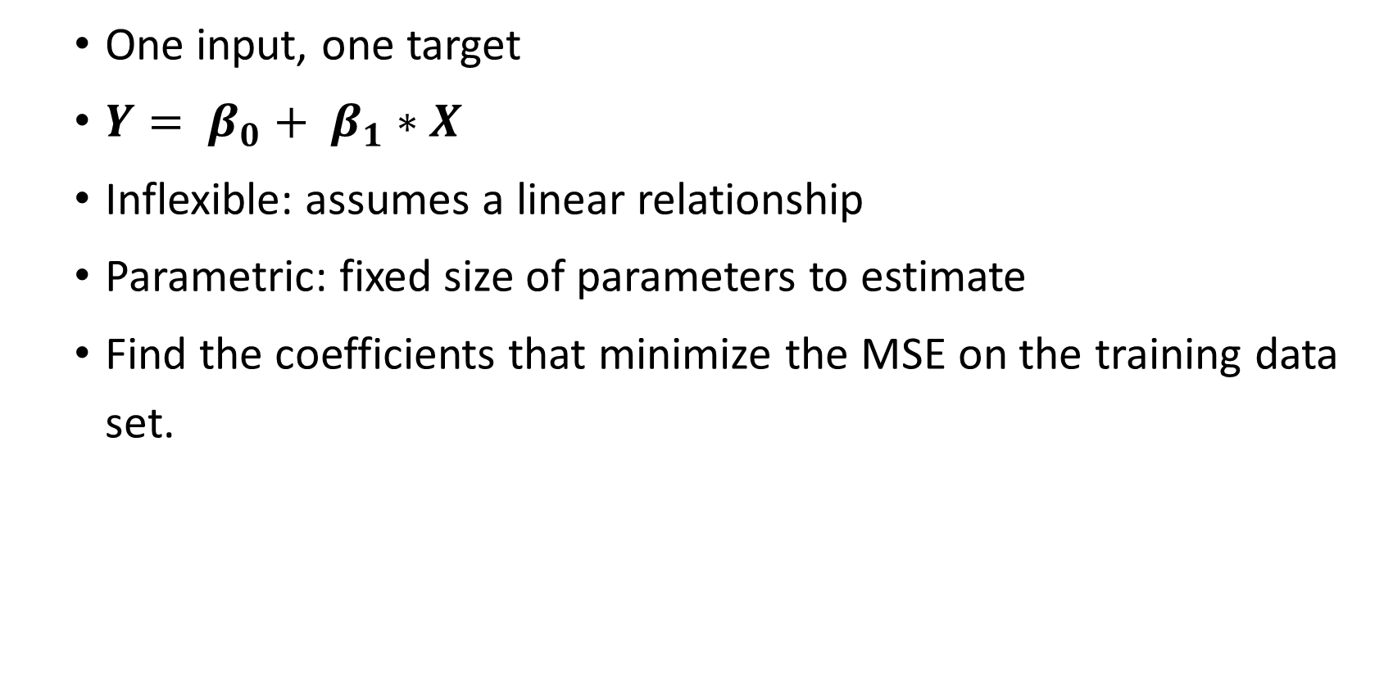
Simple linear regression (ordinary least squares)
One input, one target
$Y= β_{0}+ β_{1}∗X$
Inflexible: assumes a linear relationship
Parametric: fixed size of parameters to estimate
Find the coefficients that minimize the MSE on the training data set.

Slide 8
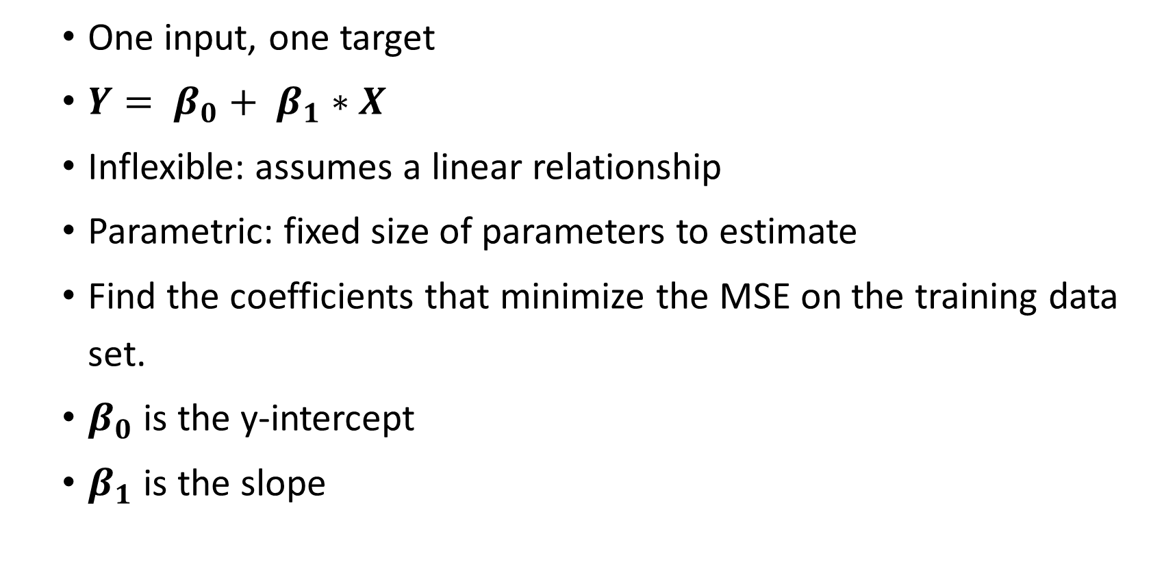
Simple linear regression (ordinary least squares)
One input, one target
$Y= β_{0}+ β_{1}∗X$
Inflexible: assumes a linear relationship
Parametric: fixed size of parameters to estimate
Find the coefficients that minimize the MSE on the training data set.
$β_{0}$ is the y-intercept
$β_{1}$ is the slope

Slide 9
Simple linear regression (ordinary least squares)
Technically, the algorithm finds coefficients which minimize the Residual Sum of Squares (RSS), not the MSE

Slide 10

Simple linear regression (ordinary least squares)
Technically, the algorithm finds coefficients which minimize the Residual Sum of Squares (RSS), not the MSE
$e_{i}= y_{i} − {\hat{y}}_{i}$

Slide 11

Simple linear regression (ordinary least squares)
Technically, the algorithm finds coefficients which minimize the Residual Sum of Squares (RSS), not the MSE
$e_{i}= y_{i} − {\hat{y}}_{i}$
$RSS= e_{1}^{2}+ e_{2}^{2}+ …+ e_{n}^{2}$

Slide 12
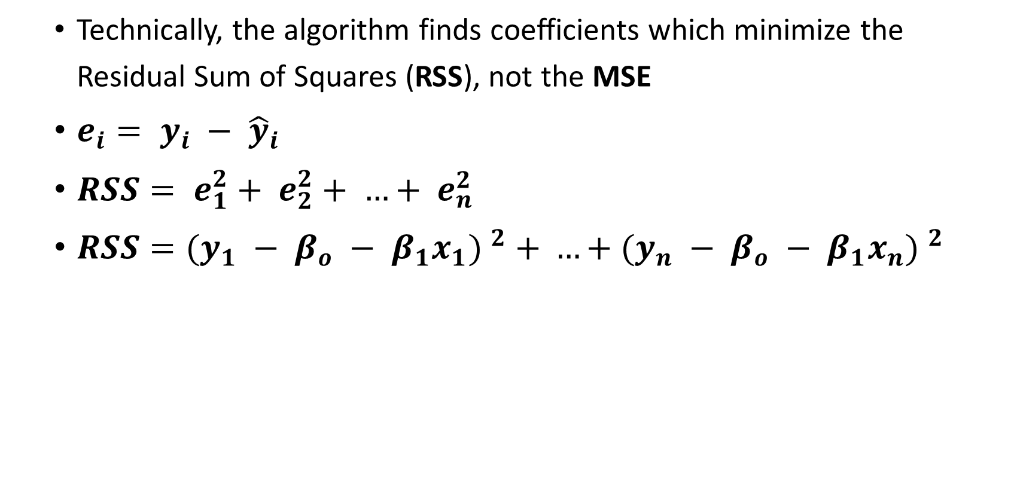
Simple linear regression (ordinary least squares)
Technically, the algorithm finds coefficients which minimize the Residual Sum of Squares (RSS), not the MSE
$e_{i}= y_{i} − {\hat{y}}_{i}$
$RSS= e_{1}^{2}+ e_{2}^{2}+ …+ e_{n}^{2}$
$RSS={(y_{1} − β_{o} − β_{1}x_{1}) }^{2} + …+{(y_{n} − β_{o} − β_{1}x_{n}) }^{2}$

Slide 13
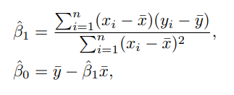
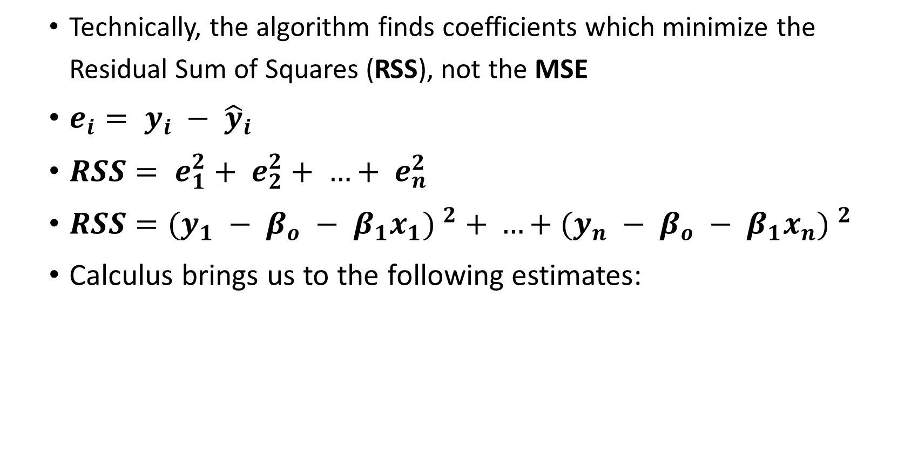
Simple linear regression (ordinary least squares)
Technically, the algorithm finds coefficients which minimize the Residual Sum of Squares (RSS), not the MSE
$e_{i}= y_{i} − {\hat{y}}_{i}$
$RSS= e_{1}^{2}+ e_{2}^{2}+ …+ e_{n}^{2}$
$RSS={(y_{1} − β_{o} − β_{1}x_{1}) }^{2} + …+{(y_{n} − β_{o} − β_{1}x_{n}) }^{2}$
Calculus brings us to the following estimates:

Slide 14
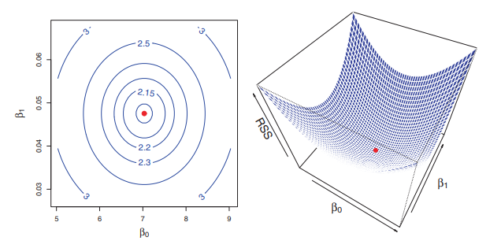
Simple linear regression (ordinary least squares)

Slide 15
Assessing the accuracy of the OLS coefficients
Once the parameters are found, accuracy of the coefficient estimates can be assessed

Slide 16

Assessing the accuracy of the OLS coefficients
Once the parameters are found, accuracy of the coefficient estimates can be assessed
This is done by taking the standard errors (SE) of the coefficients and computing the t-statistic for $β_{o}$ and $β_{1}$

Slide 17
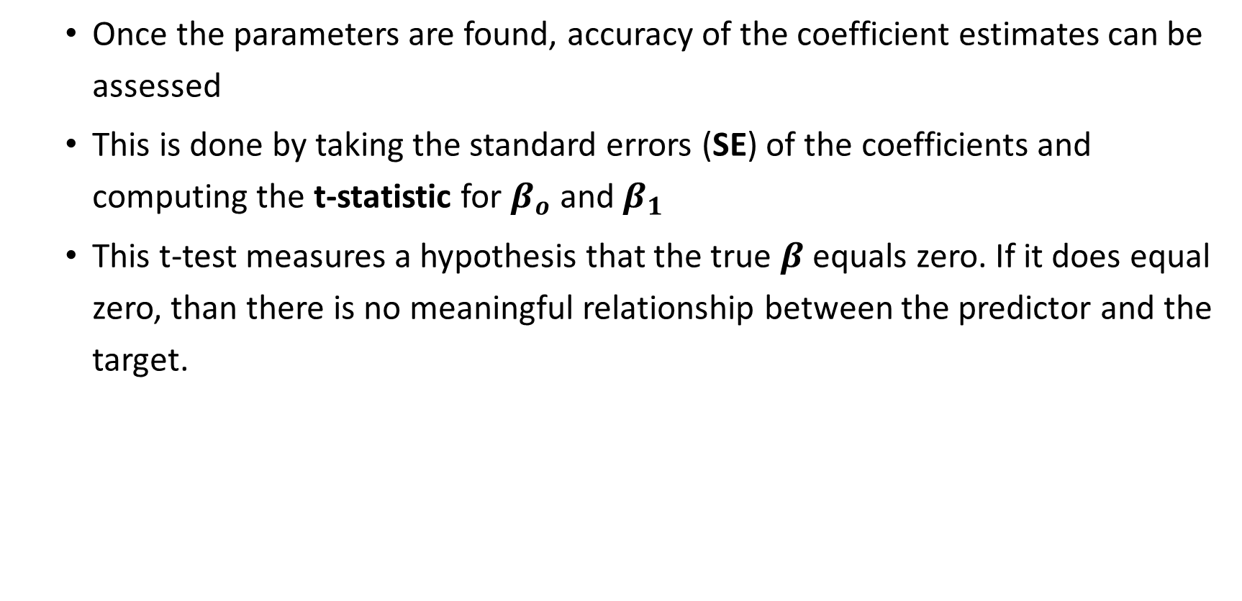
Assessing the accuracy of the OLS coefficients
Once the parameters are found, accuracy of the coefficient estimates can be assessed
This is done by taking the standard errors (SE) of the coefficients and computing the t-statistic for $β_{o}$ and $β_{1}$
This t-test measures a hypothesis that the true $β$ equals zero. If it does equal zero, than there is no meaningful relationship between the predictor and the target.

Slide 18
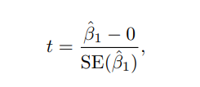
Assessing the accuracy of the OLS coefficients
Once the parameters are found, accuracy of the coefficient estimates can be assessed
This is done by taking the standard errors (SE) of the coefficients and computing the t-statistic for $β_{o}$ and $β_{1}$
This t-test measures a hypothesis that the true $β$ equals zero. If it does equal zero, than there is no meaningful relationship between the predictor and the target.

Slide 19
Assessing the accuracy of the OLS coefficients
Using a t-distribution, we convert the t-statistic into the infamous p-value for each coefficient

Slide 20
Assessing the accuracy of the OLS coefficients
Using a t-distribution, we convert the t-statistic into the infamous p-value for each coefficient
A small p-value indicates that it is unlikely to observe a strong relationship between the predictor and response due to chance.

Slide 21
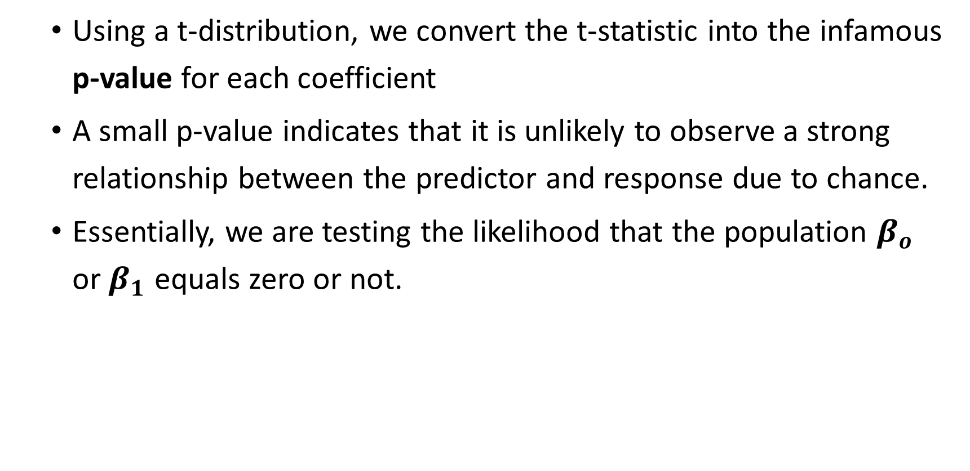
Assessing the accuracy of the OLS coefficients
Using a t-distribution, we convert the t-statistic into the infamous p-value for each coefficient
A small p-value indicates that it is unlikely to observe a strong relationship between the predictor and response due to chance.
Essentially, we are testing the likelihood that the population $β_{o}$ or $β_{1}$ equals zero or not.

Slide 22
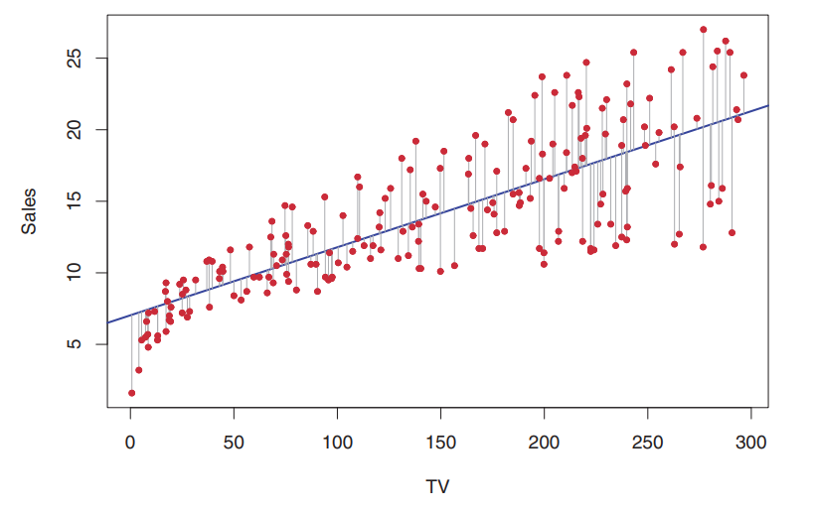
Assessing the accuracy of the OLS coefficients
Sales: How many units of a product sold (thousands)
TV: Budget for television advertisement (thousands of $)

Slide 23
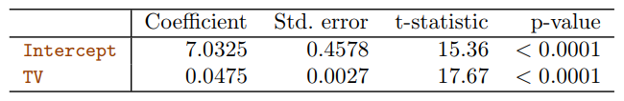
Assessing the accuracy of the OLS coefficients
Here is the final model output for a training data set

Slide 24
Assessing the accuracy of the OLS coefficients
Here is the final model output for a training data set
Look at how small the standard errors are compared to the coefficient estimates

Slide 25
Assessing the accuracy of the OLS coefficients
Here is the final model output for a training data set
Look at how small the standard errors are compared to the coefficient estimates
This results in high t-statistic, and a low p-value

Slide 26
Assessing the accuracy of the OLS coefficients
Here is the final model output for a training data set
Look at how small the standard errors are compared to the coefficient estimates
This results in high t-statistic, and a low p-value
The p-value is telling us how likely it is that the TRUE population coefficients equal zero.

Slide 27
Assessing the accuracy of the OLS coefficients
Here is the final model output for a training data set
Look at how small the standard errors are compared to the coefficient estimates
This results in high t-statistic, and a low p-value
The p-value is telling us how likely it is that the TRUE population coefficients equal zero.
In both cases, we can see that the relationship is strong enough that we can be very confident that the relationship we are capturing is real (higher TV budget will increase sales).

Slide 28
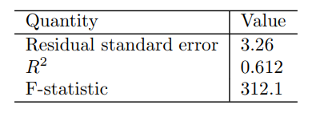
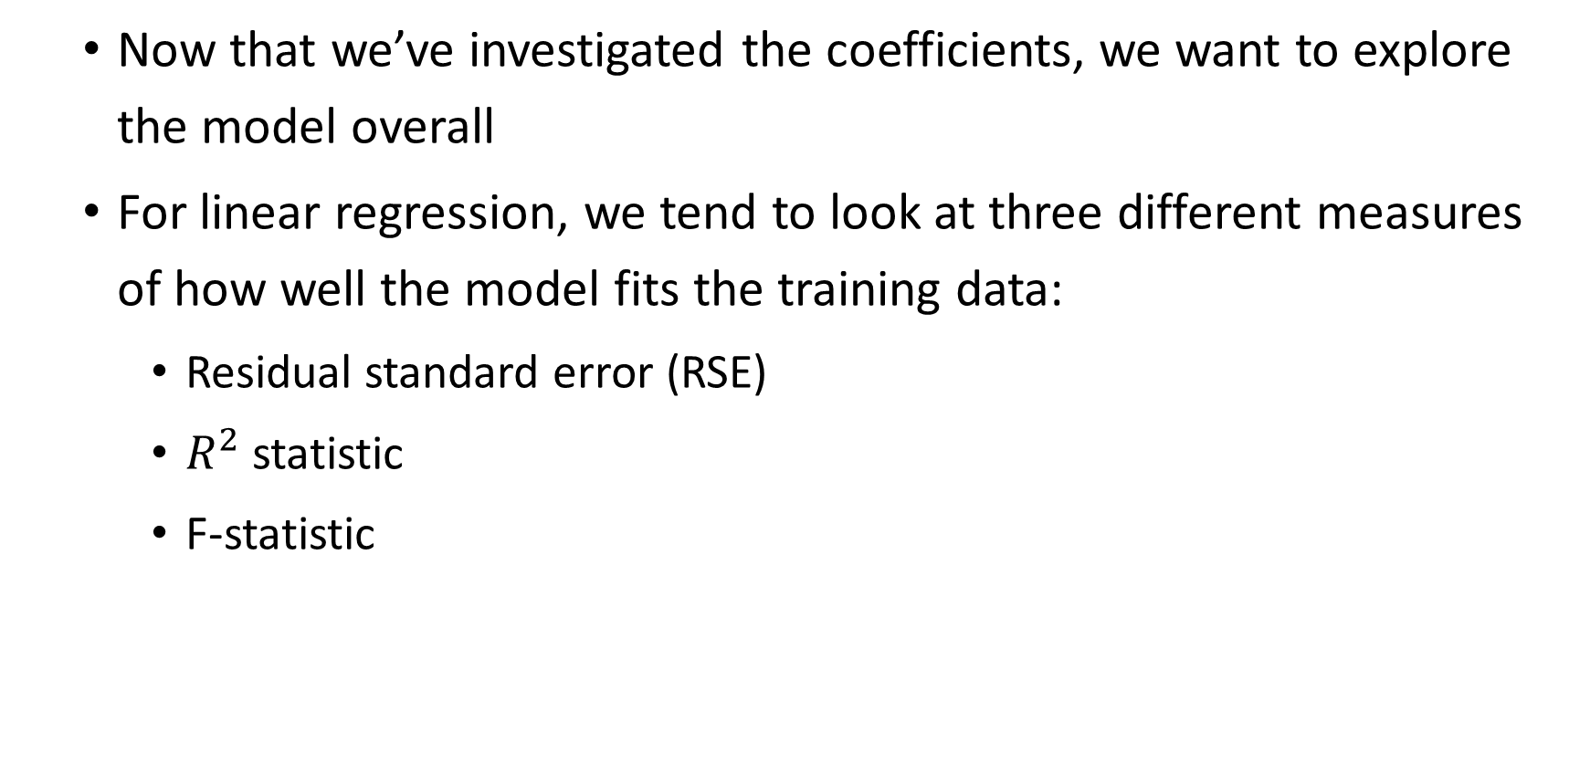
Assessing the accuracy of the model
Now that we’ve investigated the coefficients, we want to explore the model overall
For linear regression, we tend to look at three different measures of how well the model fits the training data:
Residual standard error (RSE)
$R^{2}$ statistic
F-statistic

Slide 29

Assessing the accuracy of the model
RSE is the measure of the average amount the response will deviate from the regression line (standard deviation).

Slide 30
Assessing the accuracy of the model
RSE is the measure of the average amount the response will deviate from the regression line (standard deviation).
In this case, our value is 3.26, which means actual sales in each market deviates from the regression line by an average of 3,260 units

Slide 31

Assessing the accuracy of the model
Where RSE is an absolute measure of fit, $R^{2}$ statistic is a proportion

Slide 32

Assessing the accuracy of the model
Where RSE is an absolute measure of fit, $R^{2}$ statistic is a proportion
It measures what percentage of variance in the data the model captures (range of 0 to 1)

Slide 33

Assessing the accuracy of the model
Where RSE is an absolute measure of fit, $R^{2}$ statistic is a proportion
It measures what percentage of variance in the data the model captures (range of 0 to 1)
In this example, 61% of the variability in number of sales is explained by the linear regression on TV budget

Slide 34
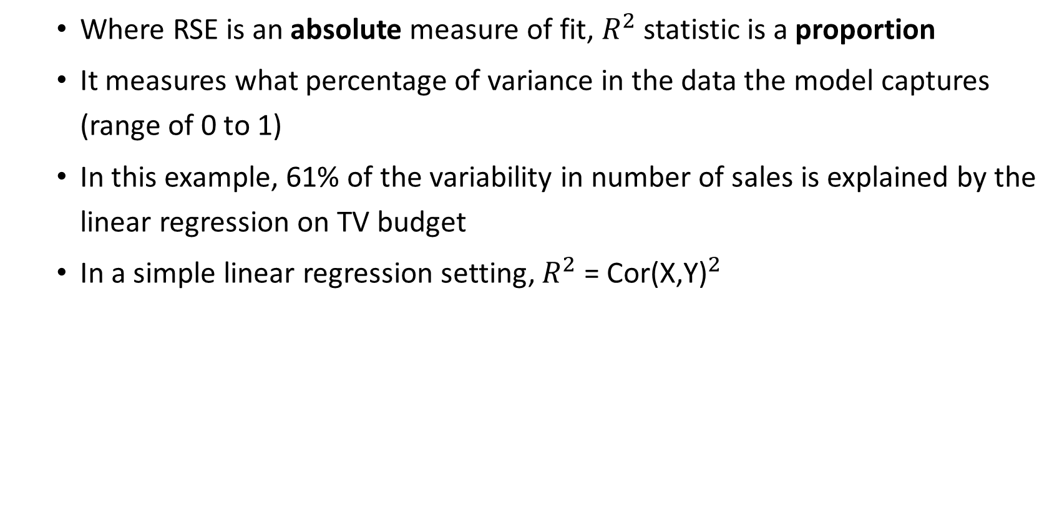
Assessing the accuracy of the model
Where RSE is an absolute measure of fit, $R^{2}$ statistic is a proportion
It measures what percentage of variance in the data the model captures (range of 0 to 1)
In this example, 61% of the variability in number of sales is explained by the linear regression on TV budget
In a simple linear regression setting, $R^{2}$ = ${\text{Cor}\text{(}\text{X}\text{,}\text{Y}\text{)}}^{2}$

Slide 35
Assessing the accuracy of the model
F-statistic is really meant for multiple linear regression

Slide 36

Assessing the accuracy of the model
F-statistic is really meant for multiple linear regression
It test the hypothesis that all slope coefficients ${\text{(}β_{o} \text{…}β}_{p})=0$

Slide 37

Assessing the accuracy of the model
F-statistic is really meant for multiple linear regression
It test the hypothesis that all slope coefficients ${\text{(}β_{o} \text{…}β}_{p})=0$
If there is no relationship between the response and the predictors, we would expect the F-statistic to be close to 1

Slide 38
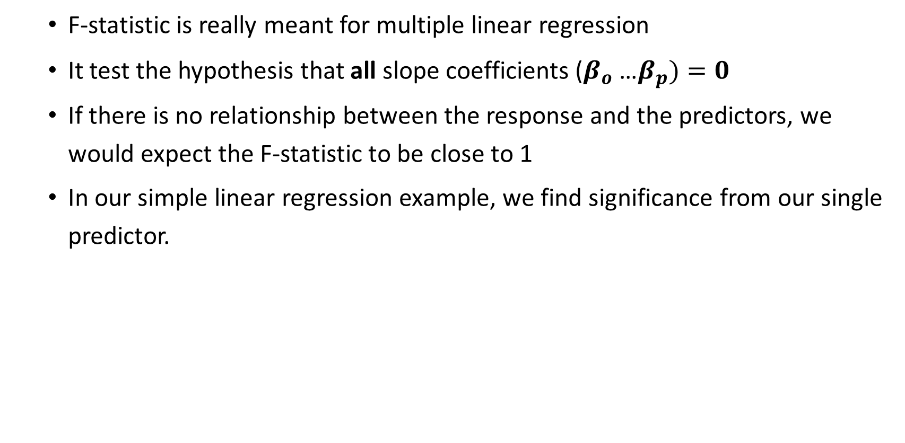
Assessing the accuracy of the model
F-statistic is really meant for multiple linear regression
It test the hypothesis that all slope coefficients ${\text{(}β_{o} \text{…}β}_{p})=0$
If there is no relationship between the response and the predictors, we would expect the F-statistic to be close to 1
In our simple linear regression example, we find significance from our single predictor.

Slide 39
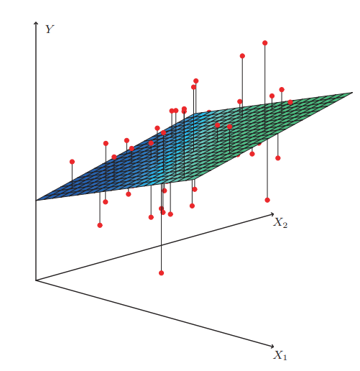
MUILTIPLE linear regression
Now let’s generalize the model to fit many predictors

Slide 40

MUILTIPLE linear regression
Now let’s generalize the model to fit many predictors
$Y= β_{0}+ β_{1}∗X_{1}+ β_{2}∗X_{2}+…+ β_{p}∗X_{p}+ ε$

Slide 41
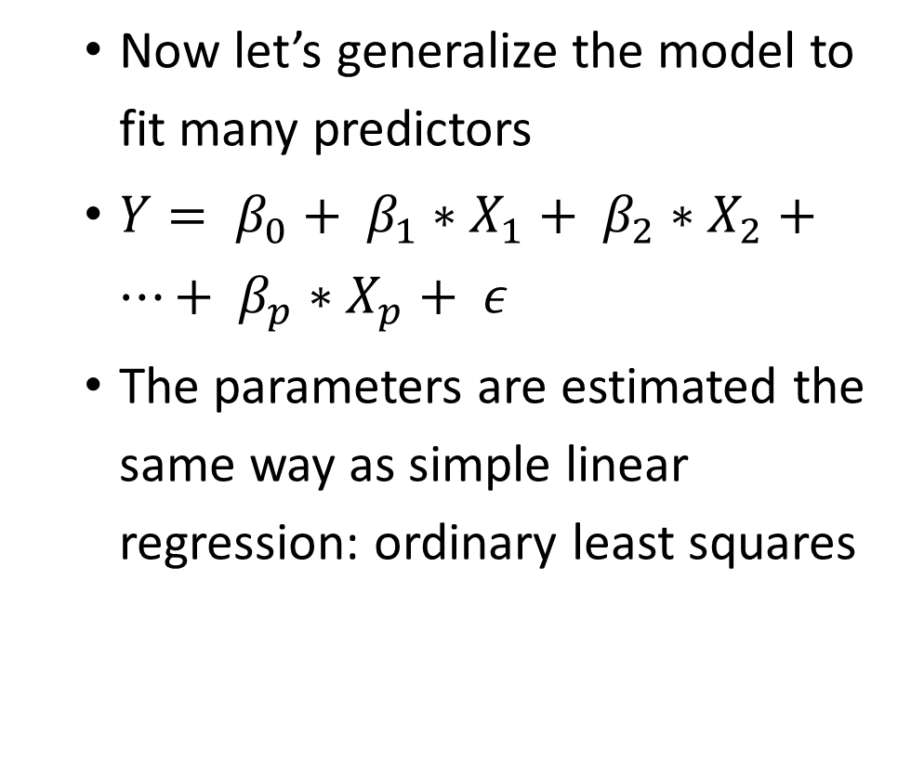
MUILTIPLE linear regression
Now let’s generalize the model to fit many predictors
$Y= β_{0}+ β_{1}∗X_{1}+ β_{2}∗X_{2}+…+ β_{p}∗X_{p}+ ε$
The parameters are estimated the same way as simple linear regression: ordinary least squares

Slide 42
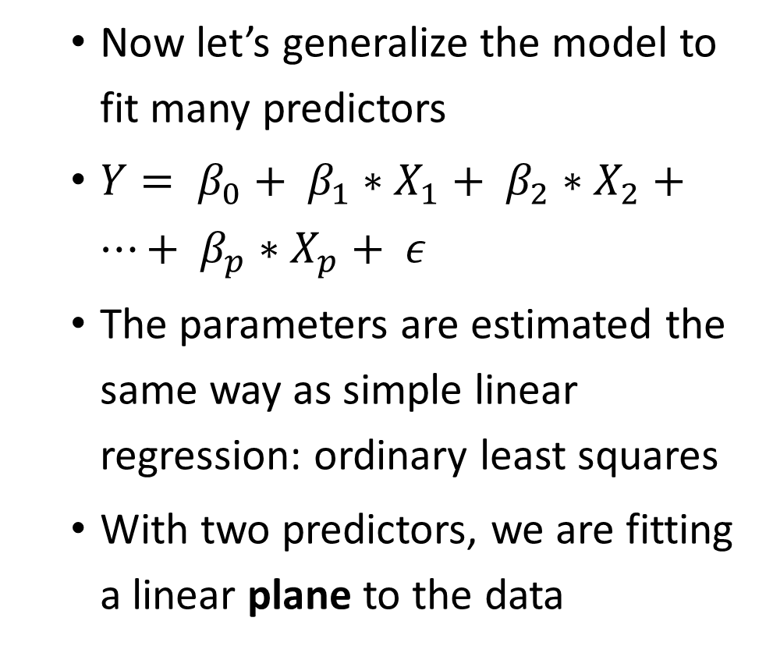
MUILTIPLE linear regression
Now let’s generalize the model to fit many predictors
$Y= β_{0}+ β_{1}∗X_{1}+ β_{2}∗X_{2}+…+ β_{p}∗X_{p}+ ε$
The parameters are estimated the same way as simple linear regression: ordinary least squares
With two predictors, we are fitting a linear plane to the data

Slide 43
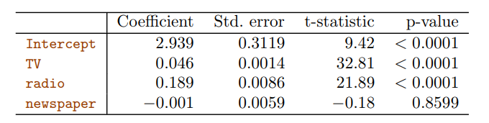
MUILTIPLE linear regression
Going back to the sales example, we can now pull in other variables: budget spent on radio and newspaper

Slide 44
MUILTIPLE linear regression
Going back to the sales example, we can now pull in other variables: budget spent on radio and newspaper
At first glance, we see that TV and radio are both highly significant

Slide 45
MUILTIPLE linear regression
Going back to the sales example, we can now pull in other variables: budget spent on radio and newspaper
At first glance, we see that TV and radio are both highly significant
But why is newspaper spending so insignificant?

Slide 46
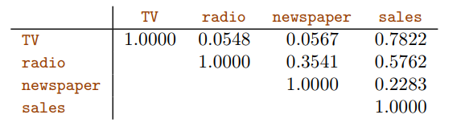
MUILTIPLE linear regression
This correlation matrix helps explain what is happening

Slide 47
MUILTIPLE linear regression
This correlation matrix helps explain what is happening
There is decently high positive correlation between newspaper and radio budget

Slide 48
MUILTIPLE linear regression
This correlation matrix helps explain what is happening
There is decently high positive correlation between newspaper and radio budget
Markets that spend higher in radio advertising are also likely to spend more in newspaper advertising

Slide 49
MUILTIPLE linear regression
Because of the high correlation between radio and newspaper, we end up not gaining any additional explanatory power by having newspaper as part of our model

Slide 50
MUILTIPLE linear regression
Because of the high correlation between radio and newspaper, we end up not gaining any additional explanatory power by having newspaper as part of our model
This may seem counterintuitive, and we will explain more later

Slide 51
MUILTIPLE linear regression
Important questions when working with many predictors:
Is at least one of the predictors useful in predicting the response (F-statistic)?
Do all predictors help explain the response, or only a subset?
How well does the model fit the data?
Given a set of input values, what response should we predict, and how accurate are the model predictions?

Slide 52
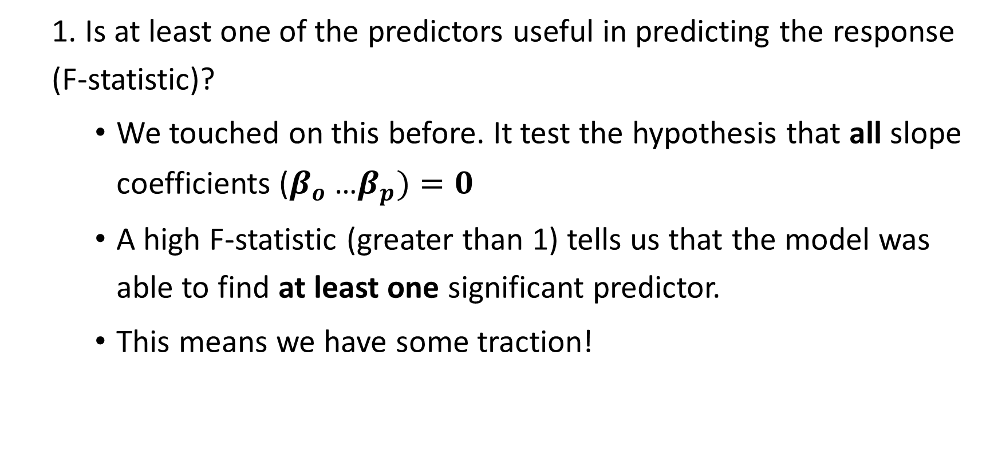
MUILTIPLE linear regression
1. Is at least one of the predictors useful in predicting the response (F-statistic)?
We touched on this before. It test the hypothesis that all slope coefficients ${\text{(}β_{o} \text{…}β}_{p})=0$
A high F-statistic (greater than 1) tells us that the model was able to find at least one significant predictor.
This means we have some traction!

Slide 53
MUILTIPLE linear regression
2. Do all predictors help explain the response, or only a subset?
Now we know, based on our F-stat, that there is SOME predictive power in our set of predictors
We can select which predictors to use by trying out different combinations and measuring each model’s RSS (what we are trying to minimize)

Slide 54
MUILTIPLE linear regression
2. Do all predictors help explain the response, or only a subset?
Forward selection:
Fit a simple linear regression to each predictor.

Slide 55
MUILTIPLE linear regression
2. Do all predictors help explain the response, or only a subset?
Forward selection:
Fit a simple linear regression to each predictor.
Pick the lowest RSS, use this predictor as your base

Slide 56
MUILTIPLE linear regression
2. Do all predictors help explain the response, or only a subset?
Forward selection:
Fit a simple linear regression to each predictor.
Pick the lowest RSS, use this predictor as your base
Fit multiple linear regression to each two-variable model, and again pick the model with lowest RSS

Slide 57
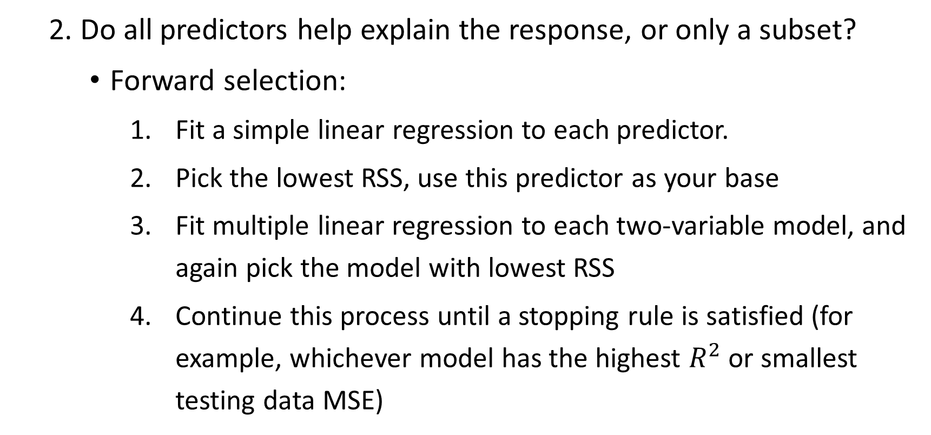
MUILTIPLE linear regression
2. Do all predictors help explain the response, or only a subset?
Forward selection:
Fit a simple linear regression to each predictor.
Pick the lowest RSS, use this predictor as your base
Fit multiple linear regression to each two-variable model, and again pick the model with lowest RSS
Continue this process until a stopping rule is satisfied (for example, whichever model has the highest $R^{2}$ or smallest testing data MSE)

Slide 58
MUILTIPLE linear regression
2. Do all predictors help explain the response, or only a subset?
Backward selection:
Add all predictors to the model

Slide 59
MUILTIPLE linear regression
2. Do all predictors help explain the response, or only a subset?
Backward selection:
Add all predictors to the model
Remove predictor with largest p-value (the least significant variable)

Slide 60
MUILTIPLE linear regression
2. Do all predictors help explain the response, or only a subset?
Backward selection:
Add all predictors to the model
Remove predictor with largest p-value (the least significant variable)
Fit new model to remaining predictors, and repeat until stopping rule is met (for example, all p-values must be below some threshold)

Slide 61
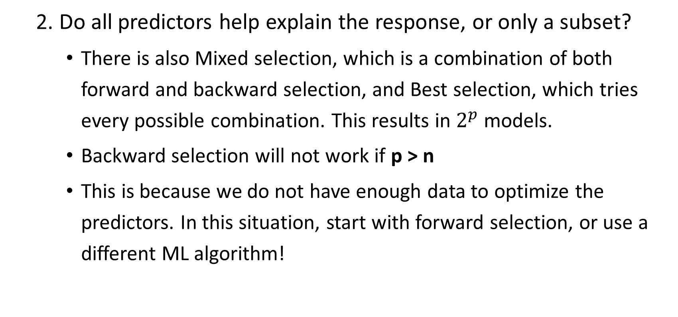
MUILTIPLE linear regression
2. Do all predictors help explain the response, or only a subset?
There is also Mixed selection, which is a combination of both forward and backward selection, and Best selection, which tries every possible combination. This results in $2^{p}$ models.
Backward selection will not work if p > n
This is because we do not have enough data to optimize the predictors. In this situation, start with forward selection, or use a different ML algorithm!

Slide 62
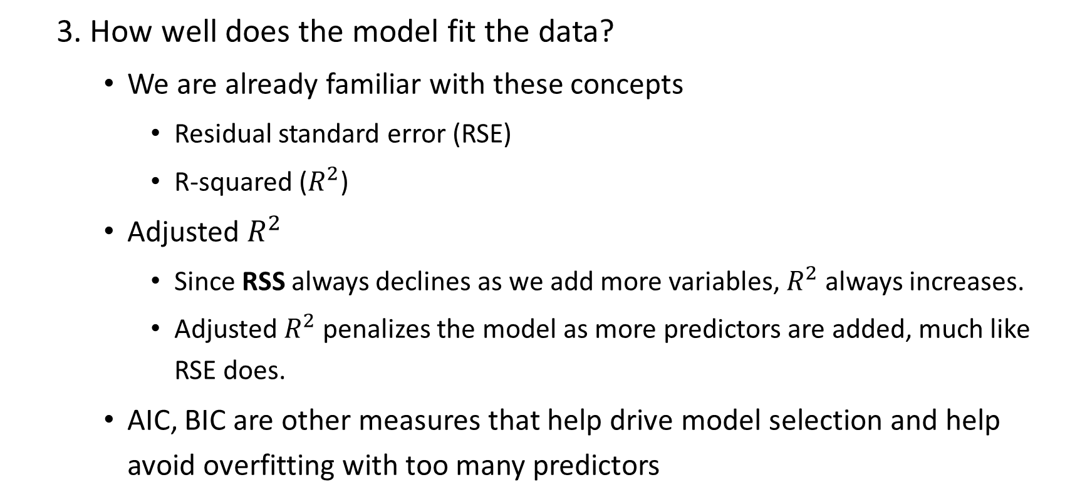
MUILTIPLE linear regression
3. How well does the model fit the data?
We are already familiar with these concepts
Residual standard error (RSE)
R-squared ($R^{2}$)
Adjusted $R^{2}$
Since RSS always declines as we add more variables, $R^{2}$ always increases.
Adjusted $R^{2}$ penalizes the model as more predictors are added, much like RSE does.
AIC, BIC are other measures that help drive model selection and help avoid overfitting with too many predictors

Slide 63
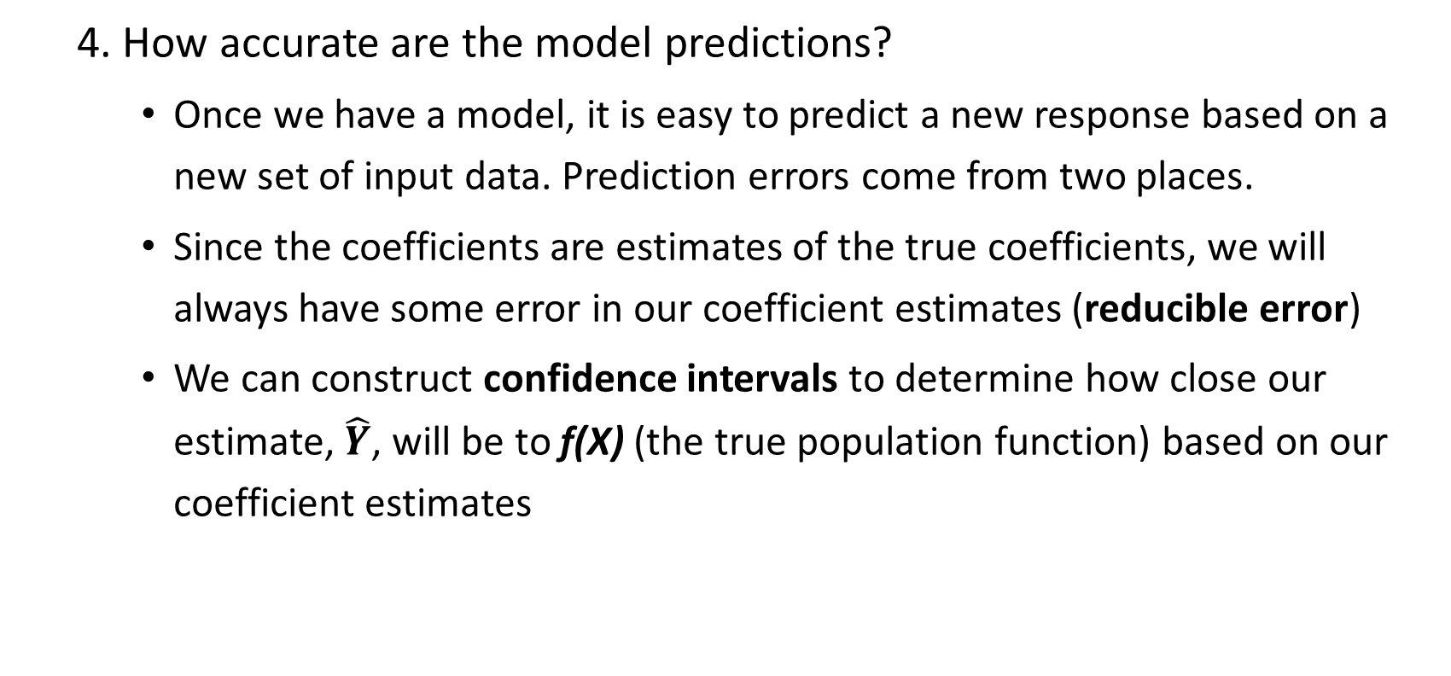
MUILTIPLE linear regression
4. How accurate are the model predictions?
Once we have a model, it is easy to predict a new response based on a new set of input data. Prediction errors come from two places.
Since the coefficients are estimates of the true coefficients, we will always have some error in our coefficient estimates (reducible error)
We can construct confidence intervals to determine how close our estimate, $\hat{Y}$, will be to f(X) (the true population function) based on our coefficient estimates

Slide 64
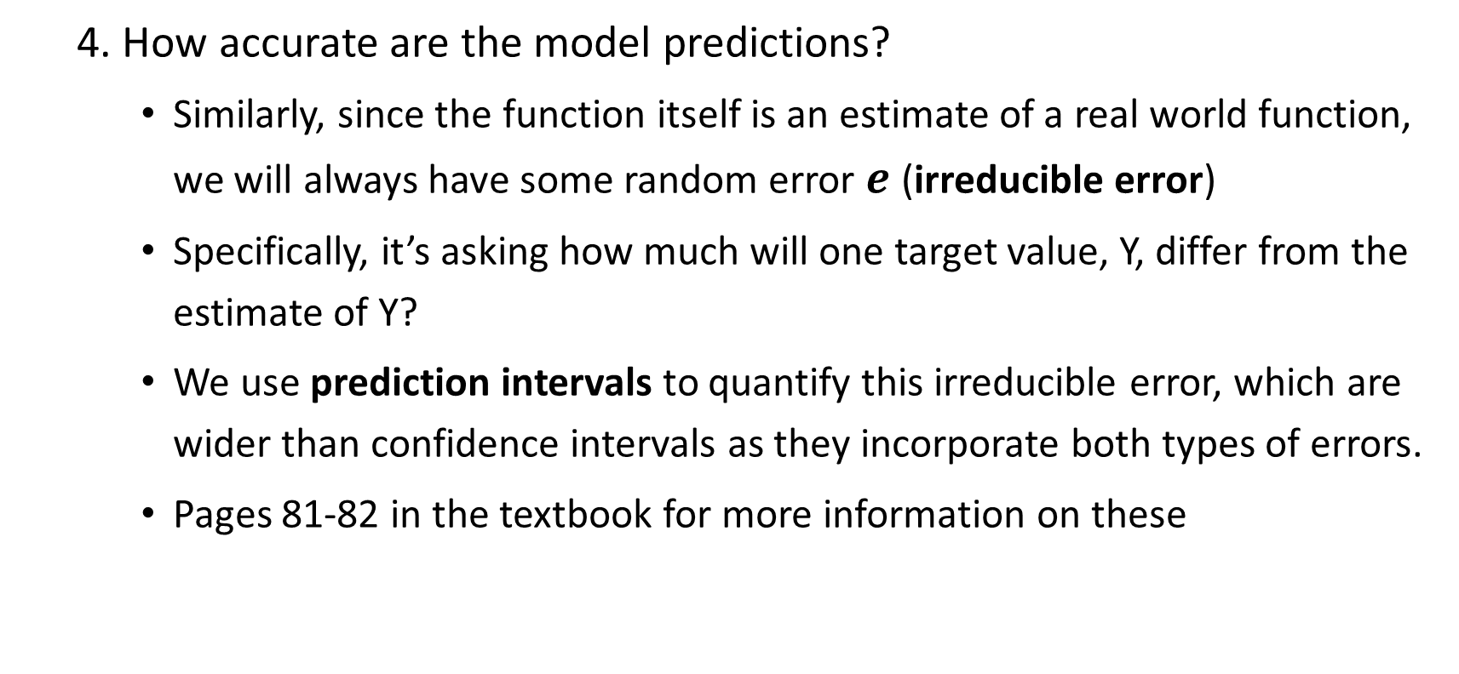
MUILTIPLE linear regression
4. How accurate are the model predictions?
Similarly, since the function itself is an estimate of a real world function, we will always have some random error $e$ (irreducible error)
Specifically, it’s asking how much will one target value, Y, differ from the estimate of Y?
We use prediction intervals to quantify this irreducible error, which are wider than confidence intervals as they incorporate both types of errors.
Pages 81-82 in the textbook for more information on these

Slide 65

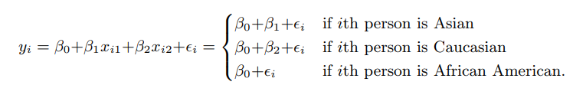
MUILTIPLE linear regression
Other considerations:
Qualitative predictors
For these types of variables, we use dummy variables

Slide 66

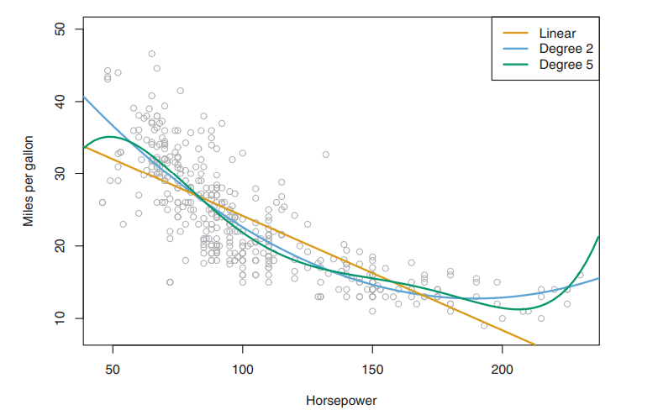
MUILTIPLE linear regression
Other considerations:
Polynomial predictors

Slide 67
MUILTIPLE linear regression
Other considerations:
Polynomial predictors
Can be used in a linear regression model for non-linear relationships

Slide 68
MUILTIPLE linear regression
Other considerations:
Polynomial predictors
Can be used in a linear regression model for non-linear relationships
This is still a linear model!

Slide 69
MUILTIPLE linear regression
Other considerations:
Polynomial predictors
Can be used in a linear regression model for non-linear relationships
This is still a linear model!
We simply create a new variable which is an exponential transformation

Slide 70
MUILTIPLE linear regression
Other considerations:
Polynomial predictors
Can be used in a linear regression model for non-linear relationships
This is still a linear model!
We simply create a new variable which is an exponential transformation
Known as polynomial regression

Slide 71
MUILTIPLE linear regression
Potential Problems
Non-linearity of the response-predictor relationship
Correlation of error terms
Non-constant variance of error terms (heteroskedasticity)
Outliars
Collinearity

Slide 72
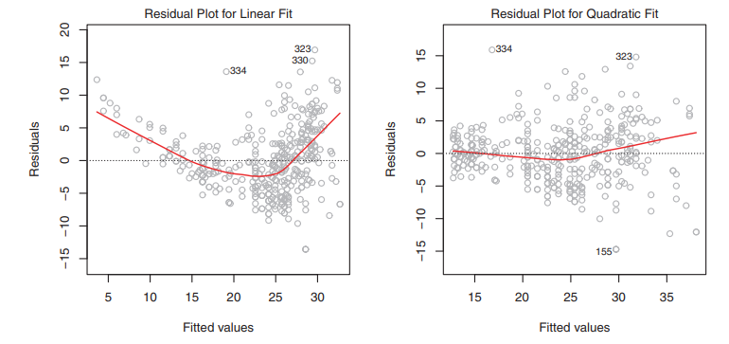

MUILTIPLE linear regression
Potential Problems - Non-linearity of the response-predictor relationship
Residual plots are used to identify this problem
We simply plot the residuals, $e_{i}= y_{i} − {\hat{y}}_{i}$ versus the fitted values

Slide 73
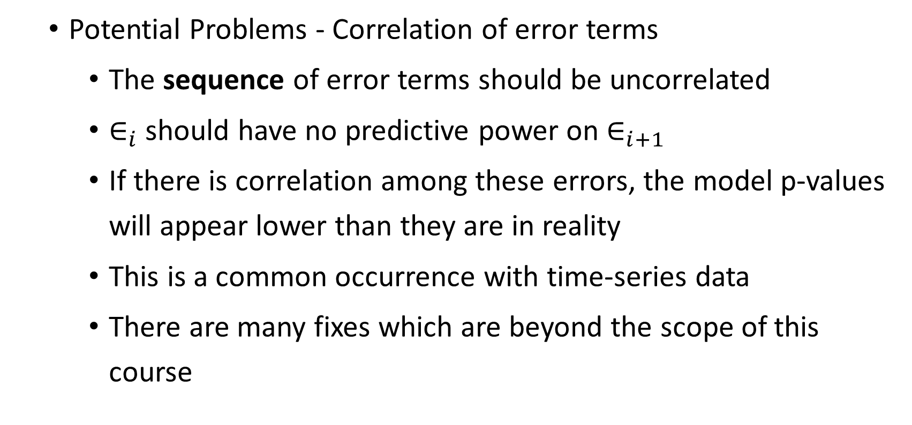
MUILTIPLE linear regression
Potential Problems - Correlation of error terms
The sequence of error terms should be uncorrelated
$∈_{i}$ should have no predictive power on $∈_{i+1}$
If there is correlation among these errors, the model p-values will appear lower than they are in reality
This is a common occurrence with time-series data
There are many fixes which are beyond the scope of this course

Slide 74
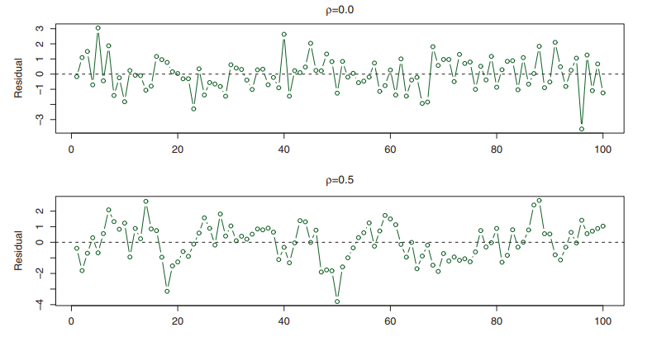
MUILTIPLE linear regression
Potential Problems - Correlation of error terms

Slide 75
MUILTIPLE linear regression
Potential Problems - Non-constant variance of error terms
Heteroskedasticity
Usually occurs when there is a wide disparity between the largest and smallest observed values
Another assumption of linear regression is that the error terms have constant variance across observations
It is easy to identify by looking for a funnel shape in the residual plot
One possible solution is to transform the response variable
E.g. transform Y to log(Y) or sqrt(Y)

Slide 76
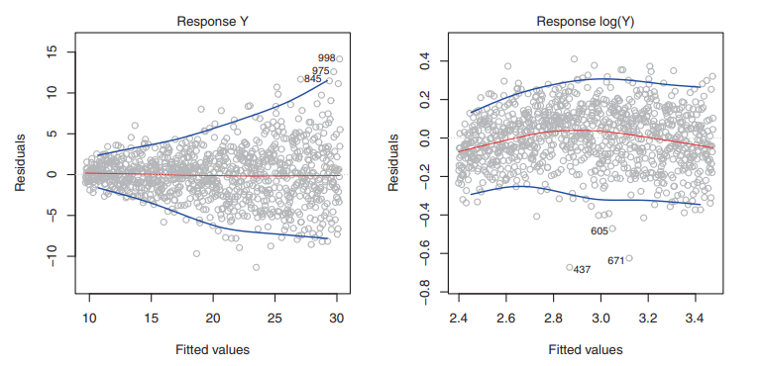
MUILTIPLE linear regression
Potential Problems - Non-constant variance of error terms

Slide 77
MUILTIPLE linear regression
Potential Problems - Outliars
An observation where the response is far outside the predicted value of the model
Can happen for a variety of reasons, including erroneous data
In practice, it can be difficult to know what to do with an outliar
Manually review residual plot and remove observations
Use sigma-clipping to automatically remove any extreme values. Might result in removal of non-outliars

Slide 78
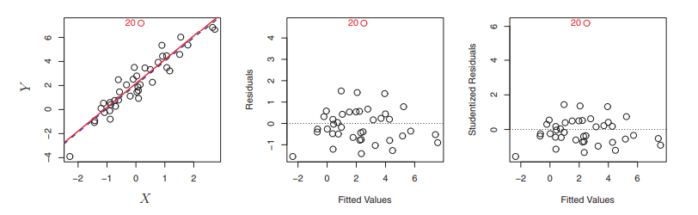
MUILTIPLE linear regression
Potential Problems - Outliars

Slide 79
MUILTIPLE linear regression
Potential Problems - Collinearity
Happens when two or more predictors are very highly correlated
If you can predict one predictor based on another, we have collinearity
As seen previously, variable selection is the best way to deal with this

Slide 80
OTHER REGRESSION TECHNIQUES
Ridge Regression
The Lasso
Elastic Net Regularization
Principal Component Regression
Total Least Squares

Slide 81
Ridge regression
Very similar to linear, except it contains a shrinkage penalty for coefficients based on a tuning parameter, lambda.

Slide 82
Ridge regression
Very similar to linear, except it contains a shrinkage penalty for coefficients based on a tuning parameter, lambda.
If lambda is set to equal zero, we are left with the OLS estimator
As lambda approaches infinity, all coefficients are penalized towards zero.

Slide 83
Ridge regression
Very similar to linear, except it contains a shrinkage penalty for coefficients based on a tuning parameter, lambda.
If lambda is set to equal zero, we are left with the OLS estimator
As lambda approaches infinity, all coefficients are penalized towards zero.
Picking the right lambda can be done using cross-validation

Slide 84
Ridge regression
Very similar to linear, except it contains a shrinkage penalty for coefficients based on a tuning parameter, lambda.
If lambda is set to equal zero, we are left with the OLS estimator
As lambda approaches infinity, all coefficients are penalized towards zero.
Picking the right lambda can be done using cross-validation
This method can find a set of coefficients which has much less variance at the cost of slightly higher bias.
Takes advantage of the bias-variance trade off
Works best when OLS estimates have high variance

Slide 85
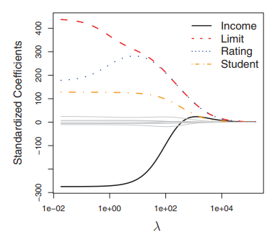
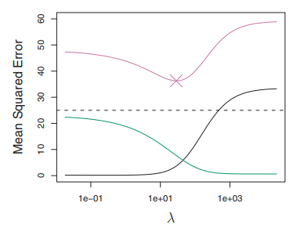
Ridge regression

Slide 86
Ridge regression
When the response – predictor relationship is mostly linear, the OLS estimates have low bias but might have high variance
This means a small change in the training data can have a large affect in the coefficient estimates
Also works well when p > n
Also works well for solving multicollinearity

Slide 87
The Lasso
Ridge Regression suffers from one disadvantage: it only shrinks unwanted coefficients, but doesn’t remove them entirely (set to zero)

Slide 88
The Lasso
Ridge Regression suffers from one disadvantage: it only shrinks unwanted coefficients, but doesn’t remove them entirely (set to zero)
The lasso is a slight twist on ridge regression

Slide 89
The Lasso
Ridge Regression suffers from one disadvantage: it only shrinks unwanted coefficients, but doesn’t remove them entirely (set to zero)
The lasso is a slight twist on ridge regression
The penalty function pushes insignificant coefficients to zero much faster

Slide 90
The Lasso
Ridge Regression suffers from one disadvantage: it only shrinks unwanted coefficients, but doesn’t remove them entirely (set to zero)
The lasso is a slight twist on ridge regression
The penalty function pushes insignificant coefficients to zero much faster
Same tuning parameter, lambda

Slide 91
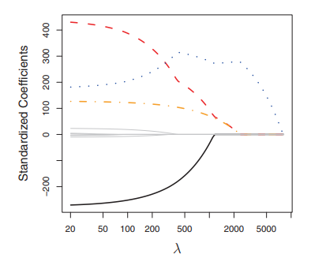

The Lasso

Slide 92
Elastic net
An improvement on limitations of both Ridge and Lasso methods
Elastic Net actually includes each model as a special case

Slide 93
Elastic net
An improvement on limitations of both Ridge and Lasso methods
Elastic Net actually includes each model as a special case
It linearly combines the coefficient penalties of both Ridge and Lasso

Slide 94

Elastic net
An improvement on limitations of both Ridge and Lasso methods
Elastic Net actually includes each model as a special case
It linearly combines the coefficient penalties of both Ridge and Lasso
Ridge penalty: $λ\sum_{j=1}^{p}{β_{j}^{2}}$

Slide 95

Elastic net
An improvement on limitations of both Ridge and Lasso methods
Elastic Net actually includes each model as a special case
It linearly combines the coefficient penalties of both Ridge and Lasso
Ridge penalty: $λ\sum_{j=1}^{p}{β_{j}^{2}}$
Lasso penalty: $λ\sum_{j=1}^{p}{|β_{j}|}$

Slide 96

Elastic net
An improvement on limitations of both Ridge and Lasso methods
Elastic Net actually includes each model as a special case
It linearly combines the coefficient penalties of both Ridge and Lasso
Ridge penalty: $λ\sum_{j=1}^{p}{β_{j}^{2}}$
Lasso penalty: $λ\sum_{j=1}^{p}{|β_{j}|}$
Elastic Net penalty:$λ∗(α∗\sum_{j=1}^{p}{β_{j}^{2}}+\left(1−α\right)∗\sum_{j=1}^{p}{|β_{j}|)}$

Slide 97

Elastic net
An improvement on limitations of both Ridge and Lasso methods
Elastic Net actually includes each model as a special case
It linearly combines the coefficient penalties of both Ridge and Lasso
Ridge penalty: $λ\sum_{j=1}^{p}{β_{j}^{2}}$
Lasso penalty: $λ\sum_{j=1}^{p}{|β_{j}|}$
Elastic Net penalty:$λ∗(α∗\sum_{j=1}^{p}{β_{j}^{2}}+\left(1−α\right)∗\sum_{j=1}^{p}{|β_{j}|)}$
Cost function: $RSS+λ∗(α∗\sum_{j=1}^{p}{β_{j}^{2}}+\left(1−α\right)∗\sum_{j=1}^{p}{|β_{j}|)}$

Slide 98
Elastic net
Why is this an improvement over Ridge and Lasso?

Slide 99
Elastic net
Why is this an improvement over Ridge and Lasso?
Encourages grouping effect – If many variables are correlated (multicollinearity), while the other methods arbitrarily focus on one variable, Elastic Net does a good job of grouping correlated variables so that all relevant features are contained in the model

Slide 100
Elastic net
Why is this an improvement over Ridge and Lasso?
Encourages grouping effect – If many variables are correlated (multicollinearity), while the other methods arbitrarily focus on one variable, Elastic Net does a good job of grouping correlated variables so that all relevant features are contained in the model
It also removes limitation on number of selected variables. With Lasso, if p >> n, Lasso will select at most n predictors. Elastic Net, however, can select as many predictors as it sees fit.

Slide 101
Principal component regression
Uses dimension reduction techniques (PCA) to transform the set of predictors into a smaller set before applying regression techniques.

Slide 102
Principal component regression
Uses dimension reduction techniques (PCA) to transform the set of predictors into a smaller set before applying regression techniques.
PCA is a unsupervised technique

Slide 103
Principal component regression
Uses dimension reduction techniques (PCA) to transform the set of predictors into a smaller set before applying regression techniques.
PCA is a unsupervised technique
It transforms the data into what are called “principal components” (PCs)

Slide 104
Principal component regression
Uses dimension reduction techniques (PCA) to transform the set of predictors into a smaller set before applying regression techniques.
PCA is a unsupervised technique
It transforms the data into what are called “principal components” (PCs)
Each PC expresses a certain amount of variability across the entire predictor dataset
Often a small number of PCs suffice to explain most variability in the data set.

Slide 105
Principal component regression
Uses dimension reduction techniques (PCA) to transform the set of predictors into a smaller set before applying regression techniques.
PCA is a unsupervised technique
It transforms the data into what are called “principal components” (PCs)
Each PC expresses a certain amount of variability across the entire predictor dataset
Often a small number of PCs suffice to explain most variability in the data set.
Solves for multicollinearity
Avoids overfitting

Slide 106

Principal component regression
First PC is in direction of most variability (green line)

Slide 107
Principal component regression
First PC is in direction of most variability (green line)
Second PC is orthogonal to the first

Slide 108
Principal component regression
First PC is in direction of most variability (green line)
Second PC is orthogonal to the first
Data is than centered and rotated to fit our PC1 / PC2 space. These are the new predictors which we fit a model to.

Slide 109
Principal component regression
As we increase the number of PCs, we are capturing smaller variance in the data (noise)

Slide 110
Principal component regression
As we increase the number of PCs, we are capturing smaller variance in the data (noise)
Generally, we should be able to find a set of PC predictors which is smaller than the set of X predictors

Slide 111
Principal component regression
As we increase the number of PCs, we are capturing smaller variance in the data (noise)
Generally, we should be able to find a set of PC predictors which is smaller than the set of X predictors
If the number of PCs is set to equal the number of predictors, than we are simply left with OLS

Slide 112
Total least squares
One assumption of OLS is that errors come from the measurement of the response variable

Slide 113
Total least squares
One assumption of OLS is that errors come from the measurement of the response variable
This assumption could lead to diluted coefficients

Slide 114
Total least squares
One assumption of OLS is that errors come from the measurement of the response variable
This assumption could lead to diluted coefficients
Errors-in-variables models are a class of regression model which assuming error also comes from measurements of our predictors as well

Slide 115
Total least squares
One assumption of OLS is that errors come from the measurement of the response variable
This assumption could lead to diluted coefficients
Errors-in-variables models are a class of regression model which assuming error also comes from measurements of our predictors as well
So, measuring errors by comparing the true response with our prediction, we measure errors using the orthogonal distance to the regression line

Slide 116

Total least squares
The coefficient in the TLS model is larger, as seen by the slope of the regression line on the right
PCA is used to determine the slope

Slide 117
REGRESSION – WRAP UP
Regression is a technique for inferring or predicting quantitative responses

Slide 118
REGRESSION – WRAP UP
Regression is a technique for inferring or predicting quantitative responses
We use the practice of feature selection when building out model

Slide 119
REGRESSION – WRAP UP
Regression is a technique for inferring or predicting quantitative responses
We use the practice of feature selection when building out model
We want to measure both coefficient significance and model accuracy

Slide 120
REGRESSION – WRAP UP
Regression is a technique for inferring or predicting quantitative responses
We use the practice of feature selection when building out model
We want to measure both coefficient significance and model accuracy
There are many issues to watch for; such as overfitting the training data, non-linearity, correlation of error terms, heteroscedasticity, outliers, and collinearity

Slide 121
REGRESSION – WRAP UP
Regression is a technique for inferring or predicting quantitative responses
We use the practice of feature selection when building out model
We want to measure both coefficient significance and model accuracy
There are many issues to watch for; such as overfitting the training data, non-linearity, correlation of error terms, heteroscedasticity, outliers, and collinearity
Build your model on a training data set, and always apply “final” model to a testing data set to get a better idea of variance of out-of-sample errors

Slide 122
REGRESSION – WRAP UP
Regression is a technique for inferring or predicting quantitative responses
We use the practice of feature selection when building out model
We want to measure both coefficient significance and model accuracy
There are many issues to watch for; such as overfitting the training data, non-linearity, correlation of error terms, heteroscedasticity, outliers, and collinearity
Build your model on a training data set, and always apply “final” model to a testing data set to get a better idea of variance of out-of-sample errors
As always, attempt many different models on your data and find one which captures the most useful information. If prediction is your goal, we use the MSE of the testing data set as our guide. (Ensemble Methods + Cross Validation)

